Slide 1



  This project is funded
  by the European Union
Improvement of forest management in Serbia as a contribution to climate change adaptation and mitigation
Twinning grant SR 16 IPA EN 02 20; contract 48-00-145/2019-28
TWINNING PROJECT: “Improvement of forest management in Serbia as a contribution to climate change adaptation and mitigation”

Slide 2
  This project is funded
  by the European Union
Forestry in the EU accession negotiation process
Forestry is a part of negotiation chapters:
11 – Agriculture and Rural Development
12 - Food Safety, Veterinary and Phytosanitary Policy
27 - Environment and Climate Change
/clusters 4 and 5 according to the new methodology/
Almost 2/3 of the Acquis is related to agriculture and the environment
TWINNING PROJECT: “Improvement of forest management in Serbia as a contribution to climate change adaptation and mitigation”

Slide 3
  This project is funded
  by the European Union
What was missing?
  National forestry programme – forest policy document
  Implementation of EUTR and FLEGT / partially implemented
  Implementation of other documents and obligations stemming from EU regulations in the field of forestry and forestry related fields
What shall be improved?
  Payment system – to be assessed and upgraded
Needs identified in the Twinning Fiche preparation phase
TWINNING PROJECT: “Improvement of forest management in Serbia as a contribution to climate change adaptation and mitigation”

Slide 4
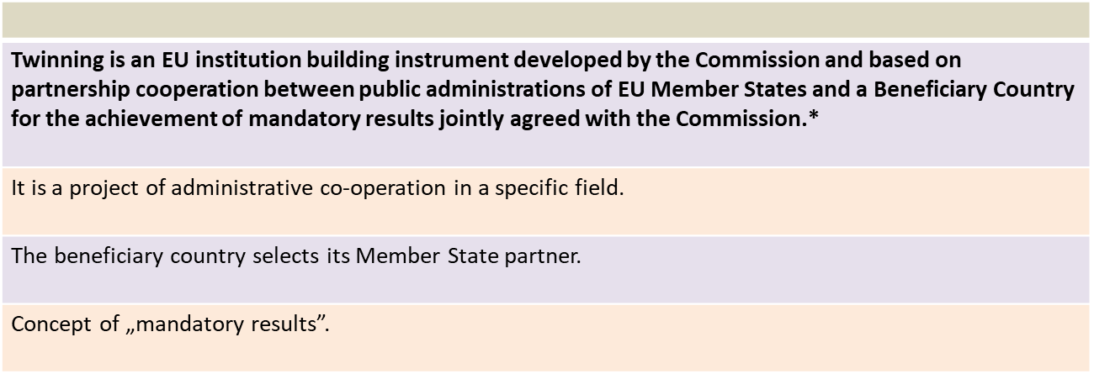
  This project is funded
  by the European Union
Twinning as the instrument of cooperation
TWINNING PROJECT: “Improvement of forest management in Serbia as a contribution to climate change adaptation and mitigation”

Slide 5
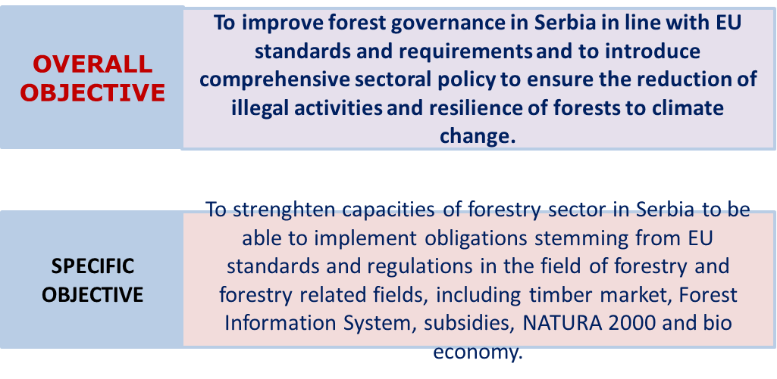
  This project is funded
  by the European Union
Project objectives
TWINNING PROJECT: “Improvement of forest management in Serbia as a contribution to climate change adaptation and mitigation”

Slide 6
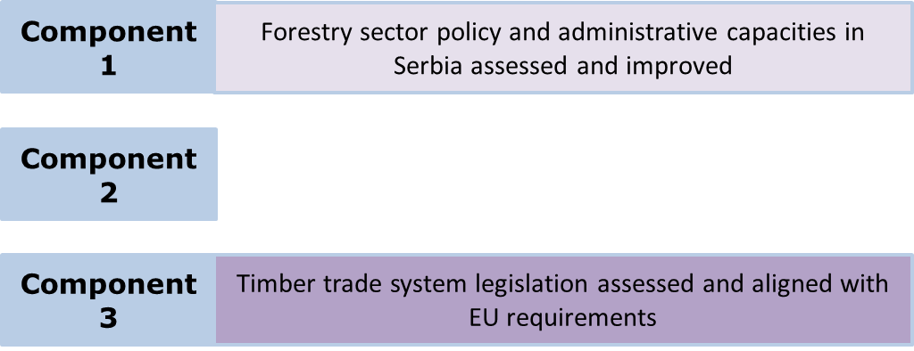

  This project is funded
  by the European Union
Mandatory results (components)
TWINNING PROJECT: “Improvement of forest management in Serbia as a contribution to climate change adaptation and mitigation”

Slide 7
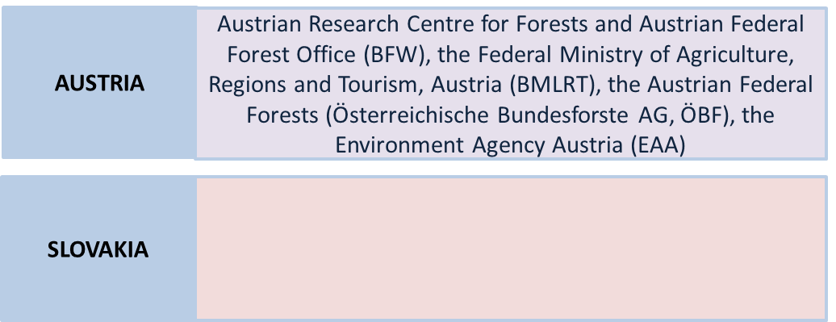


  This project is funded
  by the European Union
Twinning project consortium
TWINNING PROJECT: “Improvement of forest management in Serbia as a contribution to climate change adaptation and mitigation”

Slide 8


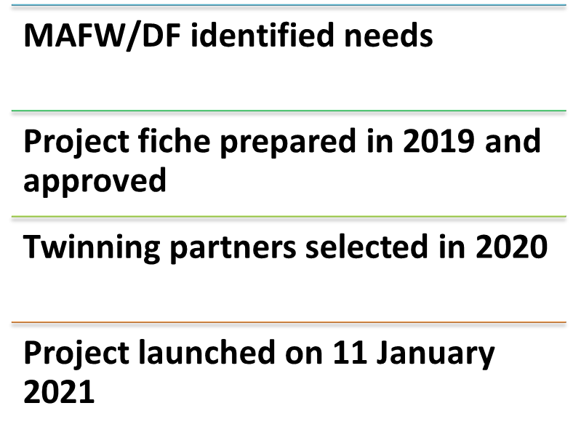
  This project is funded
  by the European Union
Mandatory results (components)
TWINNING PROJECT: “Improvement of forest management in Serbia as a contribution to climate change adaptation and mitigation”

Slide 9
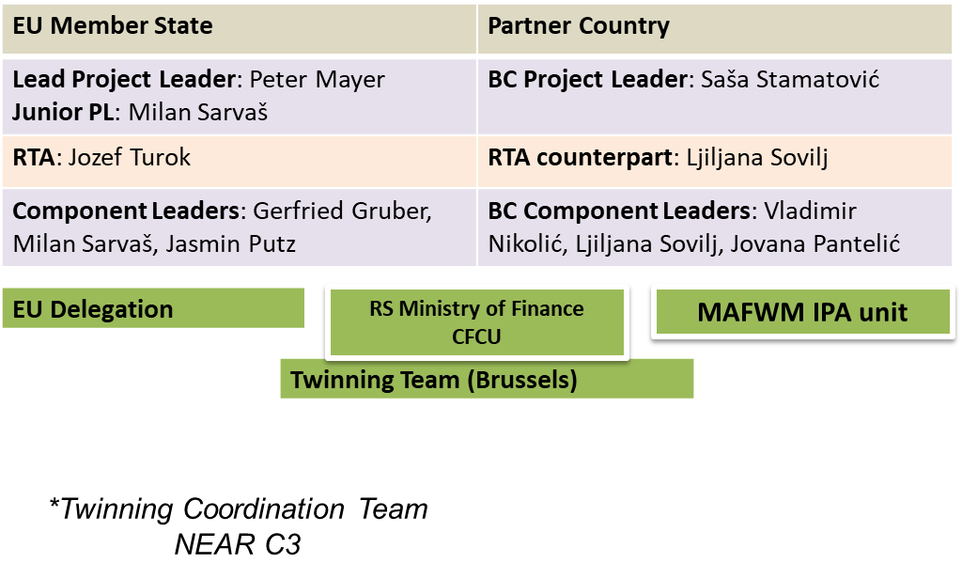
  This project is funded
  by the European Union
Twinning project coordination
TWINNING PROJECT: “Improvement of forest management in Serbia as a contribution to climate change adaptation and mitigation”

Slide 10
  This project is funded
  by the European Union
Why is Twinning very important?
All parties strive to make the project successful. An important goal is to strengthen the capacity of the beneficiary partners and stakeholders to develop the national forestry programme/policy
All experts from Serbia and the Member States work together to develop the national policy including system of payments in forestry (subsidies) and timber trade legislation, in accordance with relevant EU policies and regulations
This also involves the assessment of the current situation in forest management
In addition to that, we want to raise awareness of the Serbian public about the traditions and activities in sustainable forest management
Forests are key for climate change adaptation and mitigation
TWINNING PROJECT: “Improvement of forest management in Serbia as a contribution to climate change adaptation and mitigation”

Slide 11
  This project is funded
  by the European Union
Key partner institutions in Serbia
Besides the Ministry of Agriculture, Forestry and Water Management:
  Public companies: Srbijašume, Vojvodinašume
  National Parks Tara, Fruška gora, Đerdap, Kopaonik
  Educational, Research and Scientific Institutions: Faculty of Forestry, Institute for Forestry, Institute for Lowland Forestry and Environment
  Chamber of Forest Engineers
  Private forest owners’ associations
  Chamber of Commerce
  Pokret gorana Srbije (Foresters’ movement) and other civil society groups
  Other relevant authorities (e.g., Ministry of Environmental Protection, Ministry of Trade, Tourism and Telecommunications, Ministry of European Integration)
TWINNING PROJECT: “Improvement of forest management in Serbia as a contribution to climate change adaptation and mitigation”

Slide 12
  This project is funded
  by the European Union
MS human resources – short-term experts
The Member States partner institutions have identified more than 40 experts/civil servants as STEs, covering all project components and activities
Most STEs have previous European (including EU and national policy making) and international experience and a number of them have been involved in projects in the Western Balkan countries
TWINNING PROJECT: “Improvement of forest management in Serbia as a contribution to climate change adaptation and mitigation”

Slide 13
  This project is funded
  by the European Union
Synergies and complementarities with other international projects in Serbia
FAO/GEF Project “Contribution of Sustainable Forest Management to a Low Emission and Resilient Development” – ongoing;
Forests in women‘s hands (Interreg) – ongoing;
Serbian-German cooperation in the forestry sector: Implementation of an innovative forest management planning considering economic, ecological and social aspects in Serbia -- completed;
Coordination mechanism for cooperation between China and CEEC countries – ongoing
Natura 2000 ...
TWINNING PROJECT: “Improvement of forest management in Serbia as a contribution to climate change adaptation and mitigation”

Slide 14
  This project is funded
  by the European Union
Component 0: General activities
A0.1: Kick-off Conference – today
A0.2: Sustainability Workshop
A0.3: Closing Conference
TWINNING PROJECT: “Improvement of forest management in Serbia as a contribution to climate change adaptation and mitigation”

Slide 15
  This project is funded
  by the European Union
Component 1: Assessment and improvement of the current sector policy and administrative capacities
A1.1: Comprehensive assessment of the forestry sector in Serbia [Months 4-5]
Current state of the forestry sector analysed in cooperation with the beneficiary institutions, using tools such as SWOT and gap analyses
Gaps in relation to existing EU standards and regulations in forestry and related areas, such as timber trade and market, information systems, subsidies, NATURA 2000, LULUCF, bio-economy
First mission was held in April, second in May
Two missions with 30 STE days – completed
TWINNING PROJECT: “Improvement of forest management in Serbia as a contribution to climate change adaptation and mitigation”

Slide 16
  This project is funded
  by the European Union
Key issues, differences, gaps identified, SWOT analysis made
Institutional context in the forestry sector
System of forest management planning and implementation
Payments support system in forestry (subsidies)
Forest information system
Trade with forest products
Relevant cross-sectoral policies and legal frameworks (EU Green Deal)
Socio-economic and cultural issues
TWINNING PROJECT: “Improvement of forest management in Serbia as a contribution to climate change adaptation and mitigation”

Slide 17
  This project is funded
  by the European Union
Component 1: Assessment and improvement of the current sector policy and administrative capacities
A1.2: Road map for a national forest (development) programme [Months 6-9]
A1.3: Training plan based on in-depth training needs assessment [Months 6-9]
A1.4: Implementation of the Training plan
A1.5: Study visit to Austria and Slovakia and internship in Slovakia
TWINNING PROJECT: “Improvement of forest management in Serbia as a contribution to climate change adaptation and mitigation”

Slide 18
  This project is funded
  by the European Union
Component 2: Assessment and improvement of the current payment system in the forestry sector in Serbia
A2.1: Assessment of subsidies in the forestry sector in Serbia [Months 4-9]
Overview of forestry support systems in Austria and Slovakia (national and EU level) and their comparison with the Serbian system as a basis for the assessment of subsidies related to forest policy goals
Two missions, first was held in May, second in September
A2.2: System design for forestry subsidies
A2.3: Study visit to relevant institutions in Austria and Slovakia
A2.4: Workshop for Ministry staff and potential other beneficiaries
TWINNING PROJECT: “Improvement of forest management in Serbia as a contribution to climate change adaptation and mitigation”

Slide 19
  This project is funded
  by the European Union
Component 3: Assessment and alignment of the current timber trade system legislation in Serbia with EU requirements
A3.1: Workshops for the institutions and authorities on the current situation of timber harvesting and trade in Serbia [Months 4-9]
Identification of institutional setup and authorities involved
Competences (legislation) and control functions. This activity shall ultimately result in organisational chart of government agencies and competent authorities in the forestry sector and in the broader policy context
Workshop with government agencies
Three missions (two in June, one in September)
TWINNING PROJECT: “Improvement of forest management in Serbia as a contribution to climate change adaptation and mitigation”

Slide 20
  This project is funded
  by the European Union
Component 3: Assessment and alignment of the current timber trade system legislation in Serbia with EU requirements
A3.2: Assessment of the importance of the forestry and timber sector for Serbia’s economy [Months 4-9]
A3.3: Analysis of institutional control and traceability of timber harvested, processed and traded including identification of challenges
A3.4: Study visit to relevant institutions in Austria and Slovakia
A3.5: Recommendations/options for alignment of legislation, monitoring and enforcement including possible institutional restructuring of authorities
TWINNING PROJECT: “Improvement of forest management in Serbia as a contribution to climate change adaptation and mitigation”

Slide 21
  This project is funded
  by the European Union
Risks -- managing a twinning project at times of uncertainty
STE travel/missions in Serbia not possible due to Covid-19 (high likelihood, high impact) – remote missions
Ongoing process of EU accession negotiations in Serbia
Availability of key experts (MS and BC)
Cross-sectoral coordination (e.g., between ministries and with other public institutions) in relation to legal frameworks
Participation of key stakeholders such as private forest owners and civil society in forest policy formulation
Attitudes towards institutional reforms in the forestry sector
Governance in the forestry sector
TWINNING PROJECT: “Improvement of forest management in Serbia as a contribution to climate change adaptation and mitigation”

