Slide 1

Forests and forest management in Serbia – challenges and perspectives
Saša Stamatović, Acting director
Directorate of Forests
Belgrade,
June 22, 2021

Slide 2
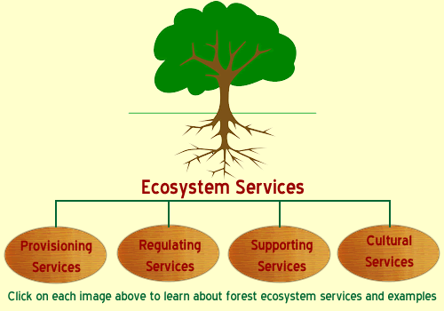
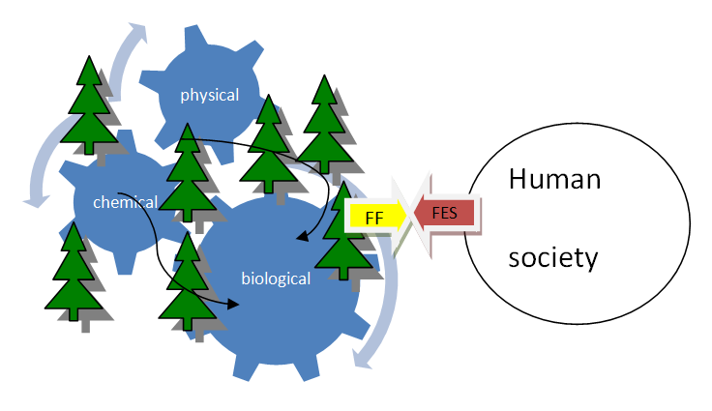


Ecosystem services / functions and modern forestry
Society
Forestry
Wood production, fresh water
Fighting climate change, Carbon sequestration
Biodiversity, habitats
Tourism, recreation

Slide 3
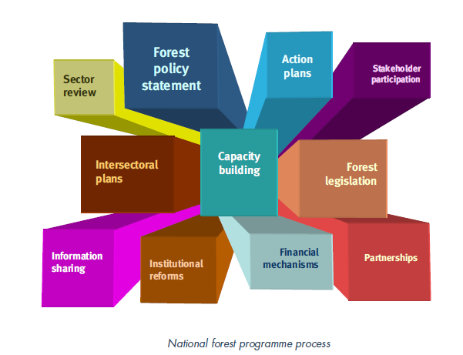
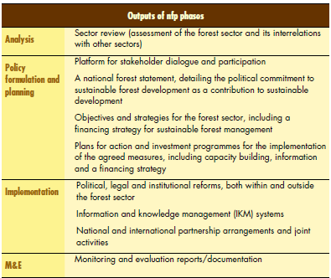
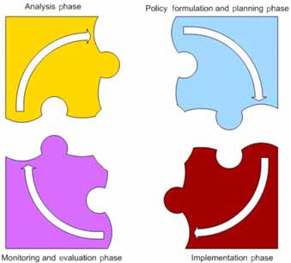
SERBIAN NATIONAL FOREST PROGRAM
Ones process starts all phases start

Slide 4
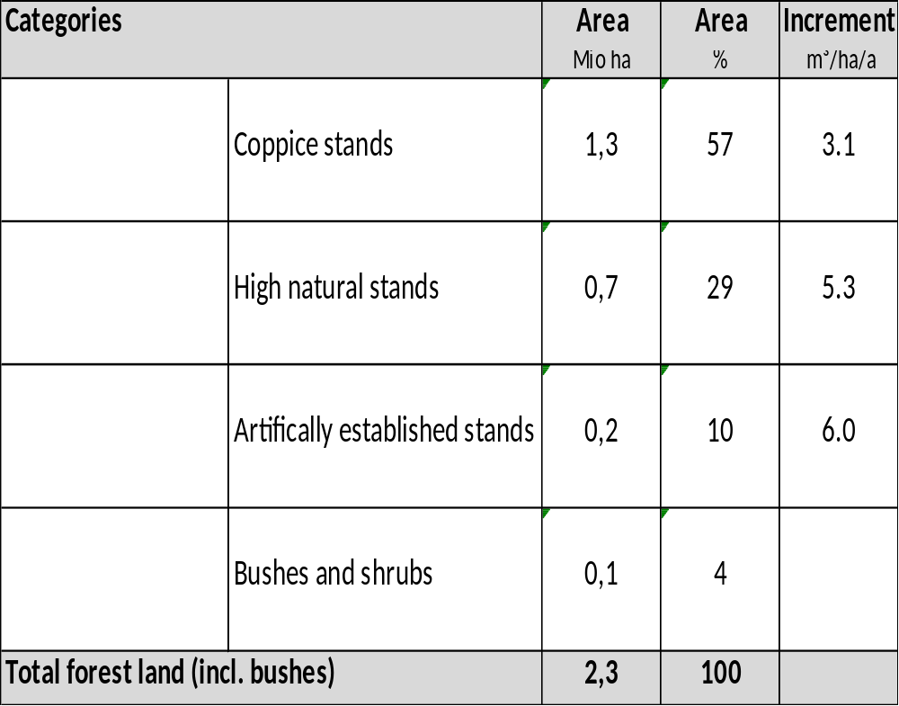
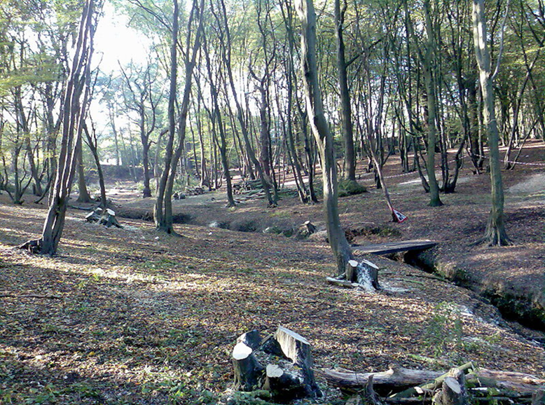
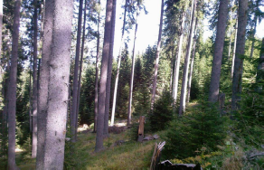
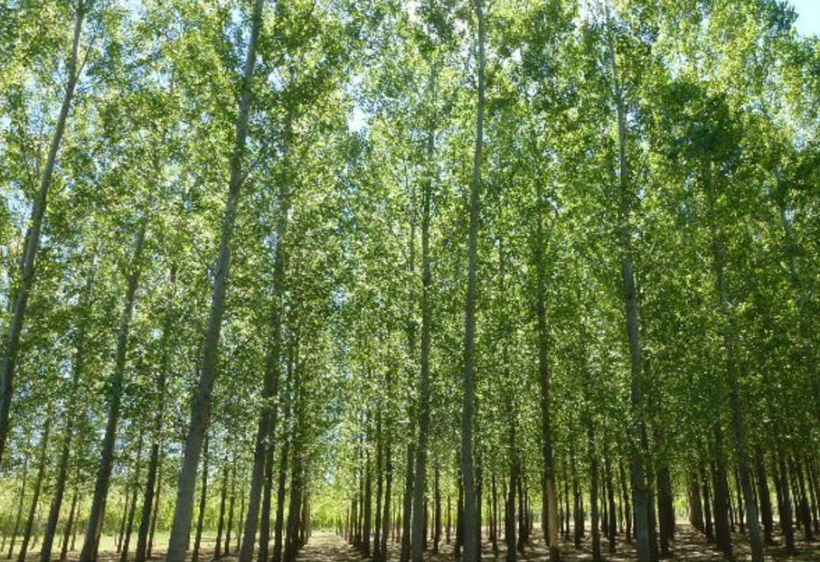
Forests and forestry sector in Serbia – resource with potentials
State of forests is mirror pictures of country’s economic, social and historical circumstances

Slide 5
Concept for Improvement of Serbian Forest Sector
Mobilization of state forestry:
Improvement of planning system
Plans realization improvement
X0.000 ha inadequate users of state forests
Mobilization of private forestry:
Associating of private forest owners
Extension service development and training
Financing/subsidizing
Conversion to high forests
Improved management
Coppice forests
Optimization of forest management
Overmatured stands
Forest Management
Intensive and timely tending
Mainly beach
Fast growing plantations
Afforestation
On non-forest land (bush, etc.)
  Systemic measures:
Strategic and legal frame
Decreasing of illegal activities
Improvement of personal and technical capacities; Road infrastructure; Forest protection; Information system
Adequate subsidizing system
Wood Market-Selling policy

Slide 6
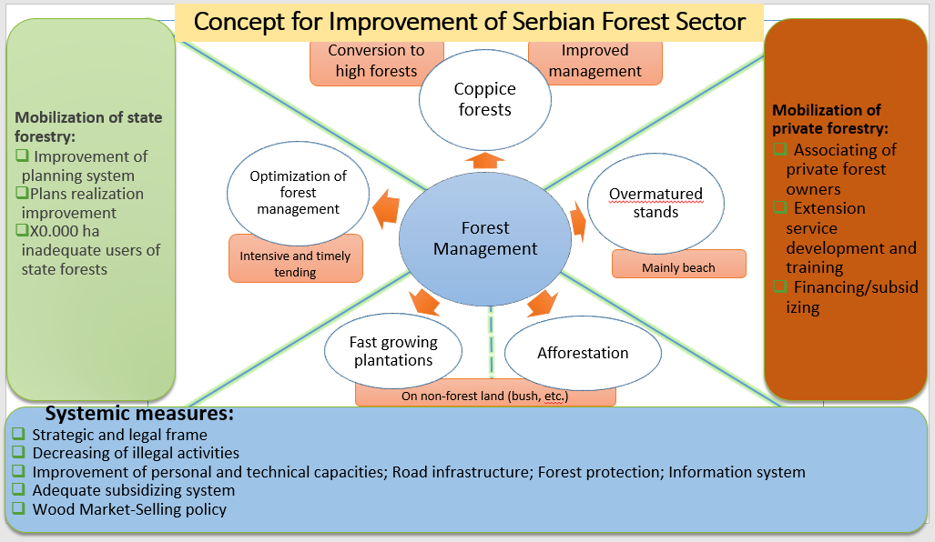
BMEL 1 & BMEL 2 Projects
Contribution of Sustainable Forest Management to a Low Emission and Resilient Development
(GEF)
NATIONAL RESOURCES
CONCEPT IMPLEMENTATION
(nfp)
“Improvement of forest management in Serbia as a contribution to climate change adaptation and mitigation“
Improvement of forestry sector
Improving the system of subsidy allocation and control
Harmonization of legislation withEUTR i FLEGT
OTHER RELATED PROJECTS

Slide 7

THANK YOU FOR YOUR ATTENTION!

